Slide 1
VECTOR SPACES
MATH 15 - Linear Algebra

Slide 2
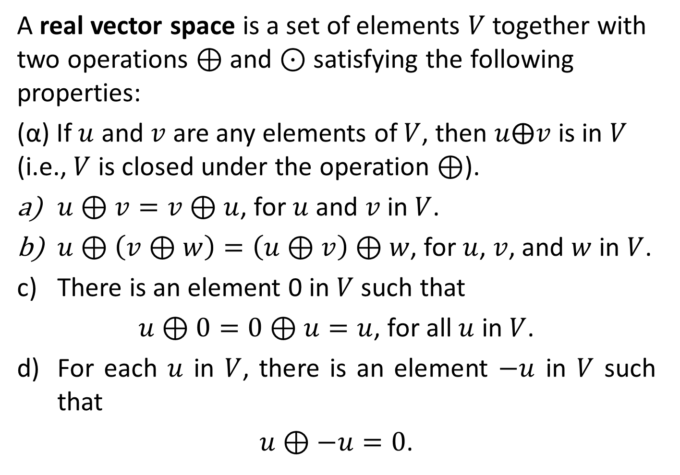
DEFINITION 1
A real vector space is a set of elements $V$ together with two operations $⊕$ and $⊙$ satisfying the following properties:
(α) If $u$ and $v$ are any elements of $V$, then $u⨁v$ is in $V$ (i.e., $V$ is closed under the operation $⊕$).
$u⊕v=v⊕u$, for $u$ and $v$ in $V$.
$u⊕\left(v⊕w\right)=\left(u⊕v\right)⊕w$, for $u$, $v$, and $w$ in $V$.
There is an element 0 in $V$ such that
$u⊕0=0⊕u=u$, for all $u$ in $V$.
For each $u$ in $V$, there is an element $−u$ in $V$ such that
$u⊕−u=0$.

Slide 3
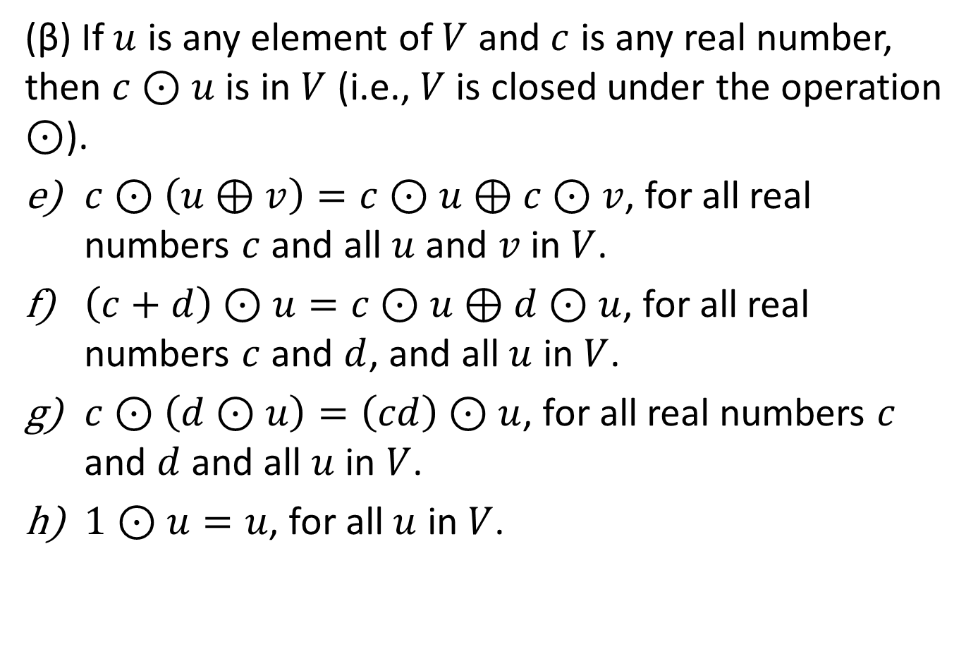
DEFINITION 1
(β) If $u$ is any element of $V$ and $c$ is any real number, then $c⊙u$ is in $V$ (i.e., $V$ is closed under the operation $⊙$).
$c⊙\left(u⊕v\right)=c⊙u⊕c⊙v$, for all real numbers $c$ and all $u$ and $v$ in $V$.
$\left(c+d\right)⊙u=c⊙u⊕d⊙u$, for all real numbers $c$ and $d$, and all $u$ in $V$.
$c⊙\left(d⊙u\right)=\left(cd\right)⊙u$, for all real numbers $c$ and $d$ and all $u$ in $V$.
$1⊙u=u$, for all $u$ in $V$.

Slide 4

DEFINITION 1
Property (α) is called the closure property for $⊕$, and (β) is called the closure property for $⊙$.

Slide 5

DEFINITION 1
The elements of $V$ are called vectors; the real numbers are called scalars. The operation $⊕$ is called vector addition; the operation $⊙$ is called scalar multiplication. The vector 0 in property (c) is called a zero vector. The vector $−u$ in property (d) is called a negative of u.

Slide 6
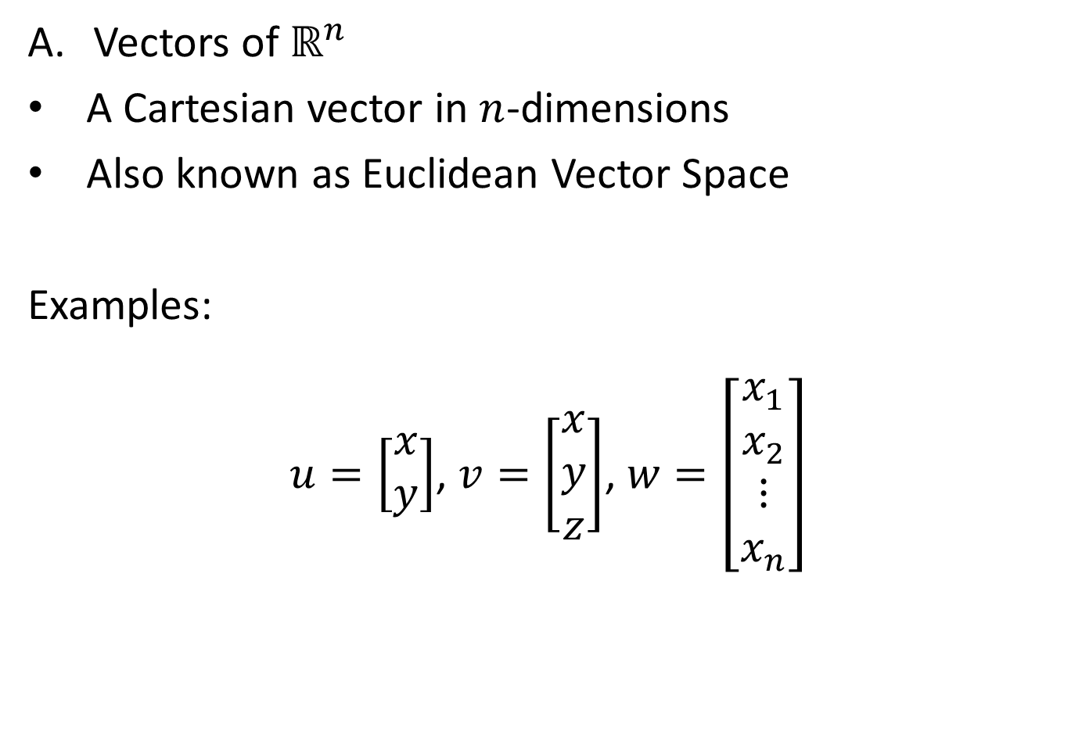
Ways of Representing Vectors
Vectors of $ℝ^{n}$
A Cartesian vector in $n$-dimensions
Also known as Euclidean Vector Space
Examples:
$u=\left[\begin{matrix}x \\ y\end{matrix}\right]$, $v=\left[\begin{matrix}x \\ y \\ z\end{matrix}\right]$, $w=\left[\begin{matrix}x_{1} \\ x_{2} \\ ⋮ \\ x_{n}\end{matrix}\right]$

Slide 7
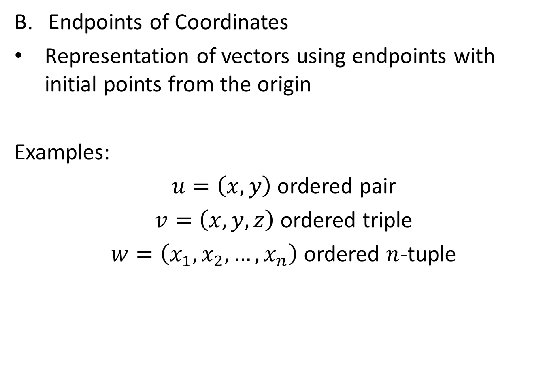
Ways of Representing Vectors
Endpoints of Coordinates
Representation of vectors using endpoints with initial points from the origin
Examples:
$u=\left(x, y\right)$ ordered pair
$v=\left(x, y, z\right)$ ordered triple
$w=\left(x_{1}, x_{2},…,x_{n}\right)$ ordered $n$-tuple

Slide 8
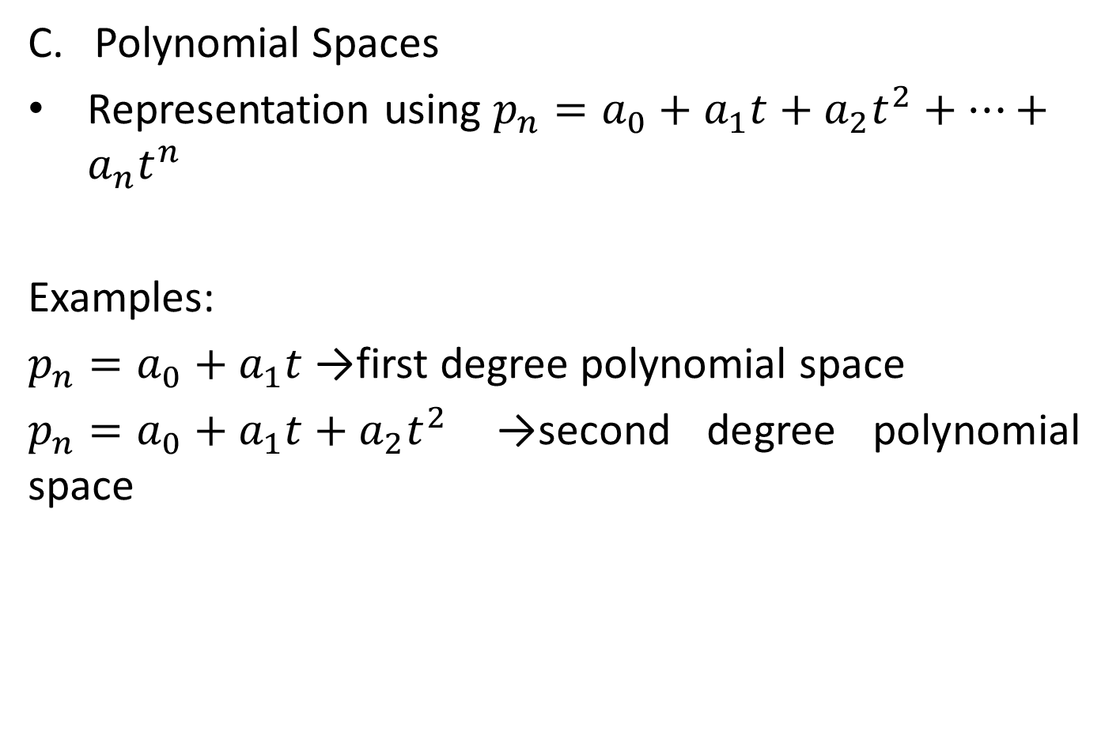
Ways of Representing Vectors
Polynomial Spaces
Representation using $p_{n}=a_{0}+a_{1}t+a_{2}t^{2}+…+a_{n}t^{n}$
Examples:
$p_{n}=a_{0}+a_{1}t$ →first degree polynomial space
$p_{n}=a_{0}+a_{1}t+a_{2}t^{2}$ →second degree polynomial space

Slide 9

Ways of Representing Vectors
Matrix Space
Representation using
$$M_{ab}=\left[\begin{matrix}a & b & c \\ d & e & f\end{matrix}\right]$$
Function Space
Representation using
$$F\left(x\right)=\left\{f\left(x\right)|x∈V\right\}$$

Slide 10

THEOREM 6.1
If $V$ is a vector space
$0u=0$, for every $u$ in $V$.
$c0=0$, for every scalar $c$.
If $cu=0$, then $c=0$ or $u=0$.
$\left(−1\right)u=−u$, for every $u$ in $V$.

Slide 11

SUBSPACES
Definition
Let $V$ be a vector space and $W$ a nonempty subset of $V$. If $W$ is a vector space with respect to the operations in $V$, then $W$ is called a subspace of $V$.

Slide 12

EXAMPLES
Every vector space has at least two subspaces, itself and the subspace $\left\{0\right\}$ consisting only of the zero vector [recall that $0⊕0=0$ and $c⊙0=0$ in any vector space]. The subspace $\left\{0\right\}$ is called the zero subspace.

Slide 13
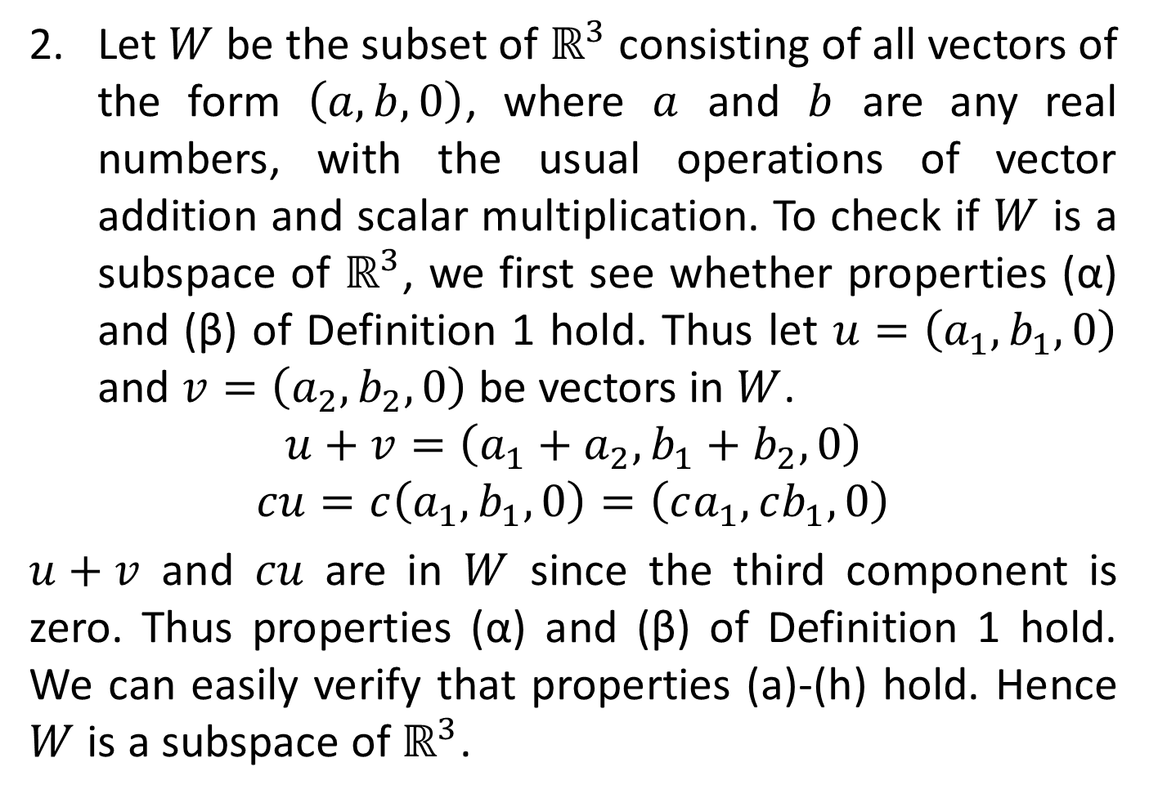
EXAMPLES
Let $W$ be the subset of $ℝ^{3}$ consisting of all vectors of the form $\left(a, b, 0\right)$, where $a$ and $b$ are any real numbers, with the usual operations of vector addition and scalar multiplication. To check if $W$ is a subspace of $ℝ^{3}$, we first see whether properties (α) and (β) of Definition 1 hold. Thus let $u=\left(a_{1}, b_{1},0\right)$ and $v=\left(a_{2},b_{2},0\right)$ be vectors in $W$.
$$u+v=\left(a_{1}+a_{2}, b_{1}+b_{2}, 0\right)$$
$$cu=c\left(a_{1},b_{1},0\right)=\left(ca_{1},cb_{1}, 0\right)$$
$u+v$ and $cu$ are in $W$ since the third component is zero. Thus properties (α) and (β) of Definition 1 hold. We can easily verify that properties (a)-(h) hold. Hence $W$ is a subspace of $ℝ^{3}$.

Slide 14

THEOREM 6.2
Let $V$ be a vector space with operations $⊕$ and $⊙$ and let $W$ be a nonempty subset of $V$. Then $W$ is a subspace of $V$ if and only if the following conditions hold:
(α) If $u$ and $v$ are any vectors in $W$, then $u⊕v$ is in $W$.
(β) If $c$ is any real number and $u$ is any vector in $W$, then $c⊙u$ is in $W$.

Slide 15
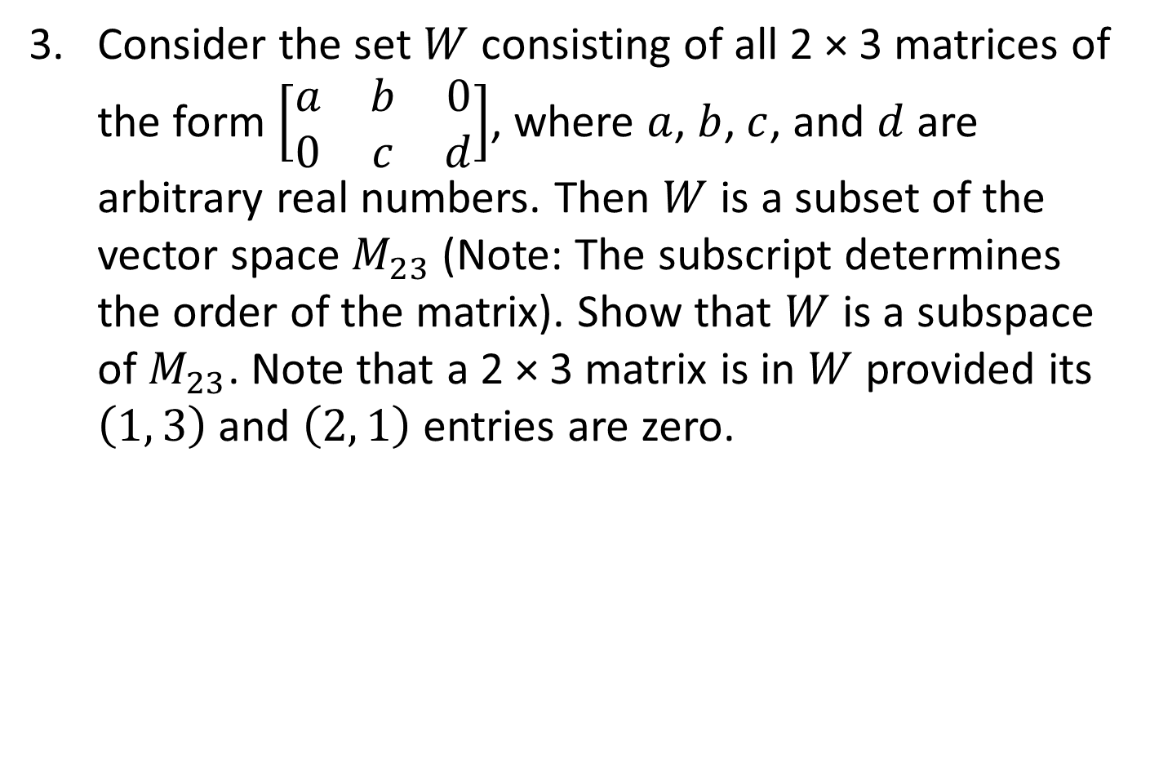
EXAMPLES
Consider the set $W$ consisting of all 2 × 3 matrices of the form $\left[\begin{matrix}a & b & 0 \\ 0 & c & d\end{matrix}\right]$, where $a$, $b$, $c$, and $d$ are arbitrary real numbers. Then $W$ is a subset of the vector space $M_{23}$ (Note: The subscript determines the order of the matrix). Show that $W$ is a subspace of $M_{23}$. Note that a 2 × 3 matrix is in $W$ provided its $\left(1, 3\right)$ and $\left(2, 1\right)$ entries are zero.

Slide 16
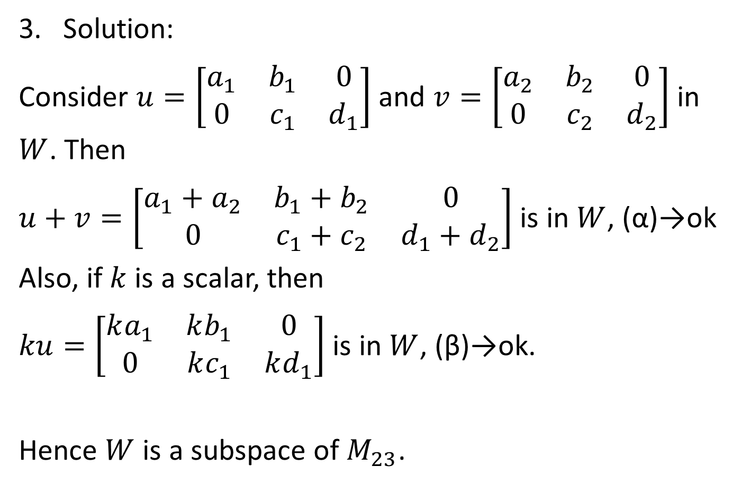
EXAMPLES
Solution:
Consider $u=\left[\begin{matrix}a_{1} & b_{1} & 0 \\ 0 & c_{1} & d_{1}\end{matrix}\right]$ and $v=\left[\begin{matrix}a_{2} & b_{2} & 0 \\ 0 & c_{2} & d_{2}\end{matrix}\right]$ in $W$. Then
$u+v=\left[\begin{matrix}a_{1}+a_{2} & b_{1}+b_{2} & 0 \\ 0 & c_{1}+c_{2} & d_{1}+d_{2}\end{matrix}\right]$ is in $W$, (α)→ok
Also, if $k$ is a scalar, then
$ku=\left[\begin{matrix}ka_{1} & kb_{1} & 0 \\ 0 & kc_{1} & kd_{1}\end{matrix}\right]$ is in $W$, (β)→ok.
Hence $W$ is a subspace of $M_{23}$.

Slide 17
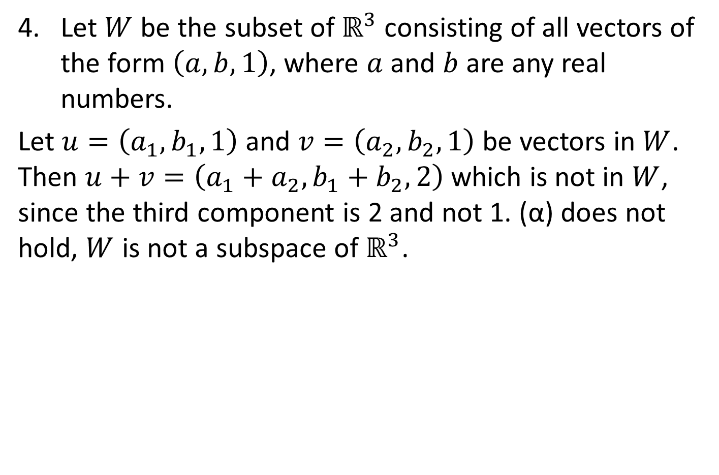
EXAMPLES
Let $W$ be the subset of $ℝ^{3}$ consisting of all vectors of the form $\left(a, b, 1\right)$, where $a$ and $b$ are any real numbers.
Let $u=\left(a_{1}, b_{1},1\right)$ and $v=\left(a_{2},b_{2},1\right)$ be vectors in $W$. Then $u+v=\left(a_{1}+a_{2}, b_{1}+b_{2}, 2\right)$ which is not in $W$, since the third component is 2 and not 1. (α) does not hold, $W$ is not a subspace of $ℝ^{3}$.

Slide 18
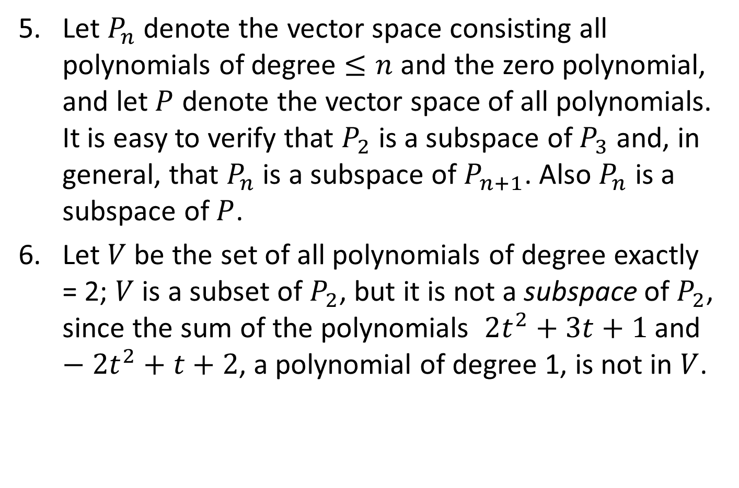
EXAMPLES
Let $P_{n}$ denote the vector space consisting all polynomials of degree $≤n$ and the zero polynomial, and let $P$ denote the vector space of all polynomials. It is easy to verify that $P_{2}$ is a subspace of $P_{3}$ and, in general, that $P_{n}$ is a subspace of $P_{n+1}$. Also $P_{n}$ is a subspace of $P$.
Let $V$ be the set of all polynomials of degree exactly = 2; $V$ is a subset of $P_{2}$, but it is not a subspace of $P_{2}$, since the sum of the polynomials $2t^{2}+3t+1$ and $−2t^{2}+t+2$, a polynomial of degree 1, is not in $V$.

Slide 19
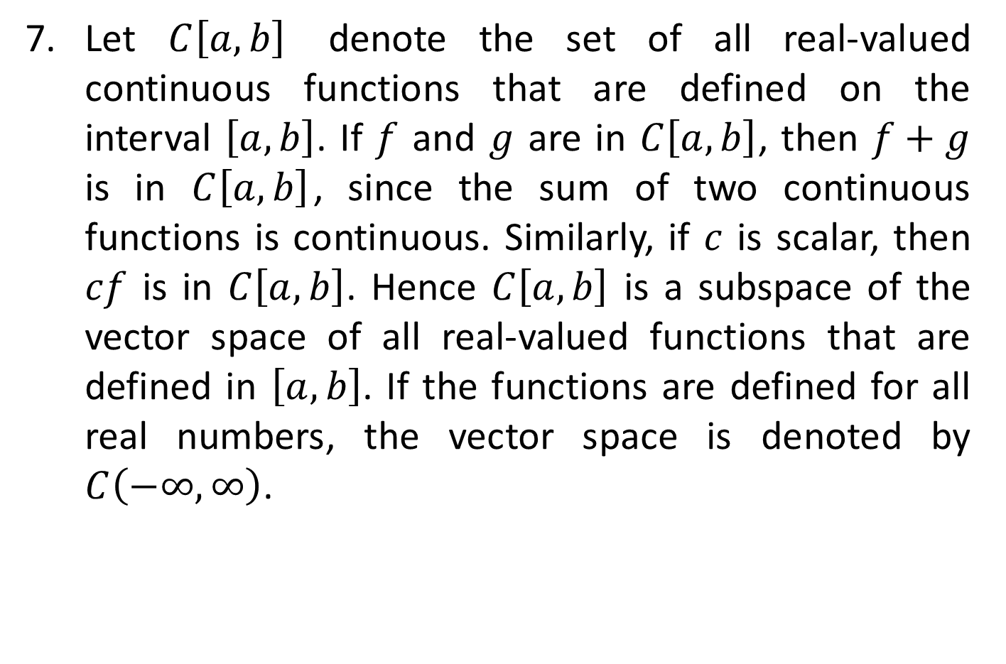
EXAMPLES
Let $C\left[a, b\right]$ denote the set of all real-valued continuous functions that are defined on the interval $\left[a, b\right]$. If $f$ and $g$ are in $C\left[a, b\right]$, then $f+g$ is in $C\left[a, b\right]$, since the sum of two continuous functions is continuous. Similarly, if $c$ is scalar, then $cf$ is in $C\left[a, b\right]$. Hence $C\left[a, b\right]$ is a subspace of the vector space of all real-valued functions that are defined in $\left[a, b\right]$. If the functions are defined for all real numbers, the vector space is denoted by $C\left(−∞, ∞\right)$.

Slide 20
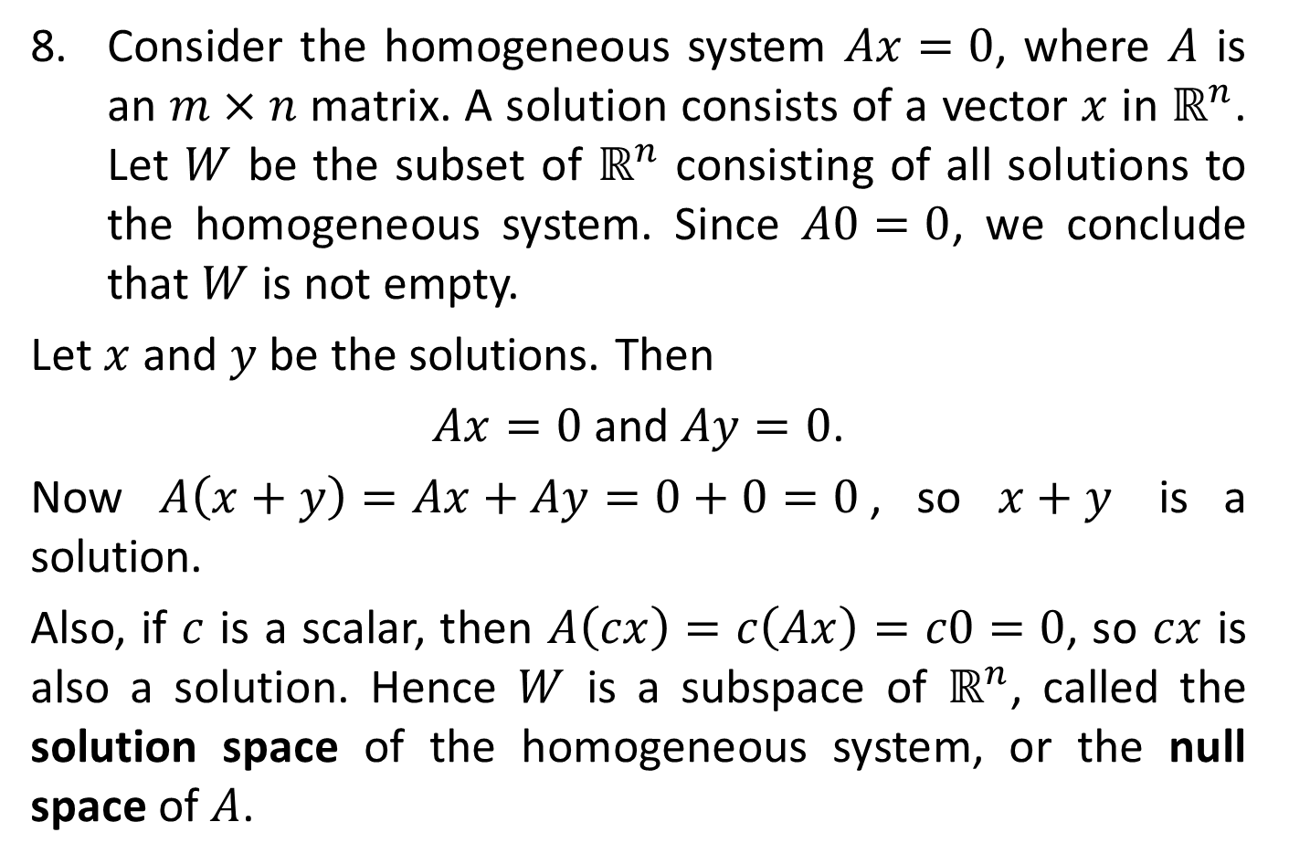
EXAMPLES
Consider the homogeneous system $Ax=0$, where $A$ is an $m×n$ matrix. A solution consists of a vector $x$ in $ℝ^{n}$. Let $W$ be the subset of $ℝ^{n}$ consisting of all solutions to the homogeneous system. Since $A0=0$, we conclude that $W$ is not empty.
Let $x$ and $y$ be the solutions. Then
$Ax=0$ and $Ay=0$.
Now $A\left(x+y\right)=Ax+Ay=0+0=0$, so $x+y$ is a solution.
Also, if $c$ is a scalar, then $A\left(cx\right)=c\left(Ax\right)=c0=0$, so $cx$ is also a solution. Hence $W$ is a subspace of $ℝ^{n}$, called the solution space of the homogeneous system, or the null space of $A$.

Slide 21

EXAMPLES
It should be noted that the set of all solutions to the linear system $Ax=b$, where $A$ is $m×n$, is not a subspace of $ℝ^{n}$ if $b≠0$.

Slide 22
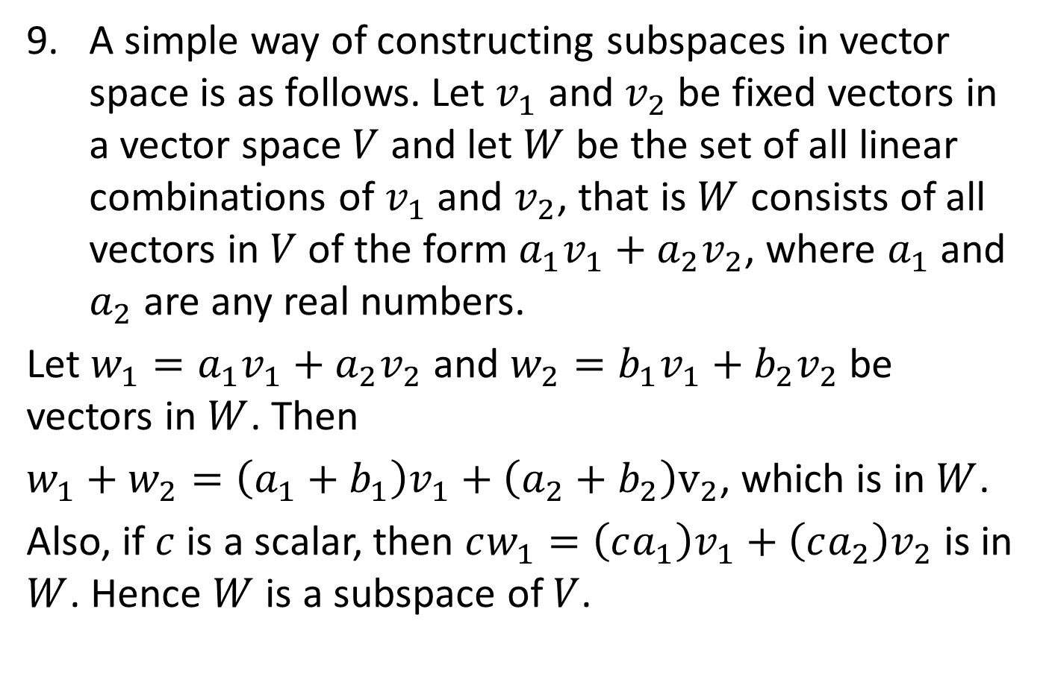
EXAMPLES
A simple way of constructing subspaces in vector space is as follows. Let $v_{1}$ and $v_{2}$ be fixed vectors in a vector space $V$ and let $W$ be the set of all linear combinations of $v_{1}$ and $v_{2}$, that is $W$ consists of all vectors in $V$ of the form $a_{1}v_{1}+a_{2}v_{2}$, where $a_{1}$ and $a_{2}$ are any real numbers.
Let $w_{1}=a_{1}v_{1}+a_{2}v_{2}$ and $w_{2}=b_{1}v_{1}+b_{2}v_{2}$ be vectors in $W$. Then
$w_{1}+w_{2}=\left(a_{1}+b_{1}\right)v_{1}+\left(a_{2}+b_{2}\right)v_{2}$, which is in $W$.
Also, if $c$ is a scalar, then $cw_{1}=\left(ca_{1}\right)v_{1}+\left(ca_{2}\right)v_{2}$ is in $W$. Hence $W$ is a subspace of $V$.

Slide 23
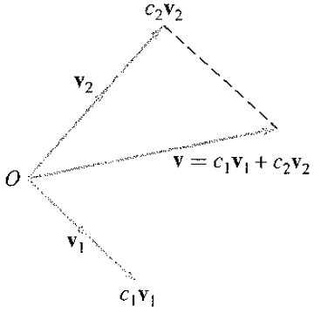
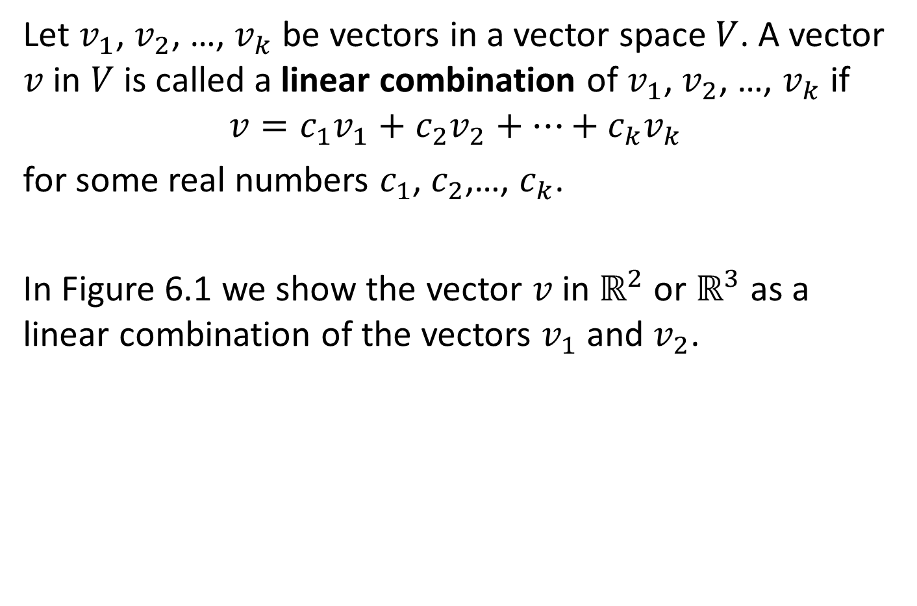
DEFINITION
Let $v_{1}$, $v_{2}$, …, $v_{k}$ be vectors in a vector space $V$. A vector $v$ in $V$ is called a linear combination of $v_{1}$, $v_{2}$, …, $v_{k}$ if
$$v=c_{1}v_{1}+c_{2}v_{2}+…+c_{k}v_{k}$$
for some real numbers $c_{1}$, $c_{2}$,…, $c_{k}$.
In Figure 6.1 we show the vector $v$ in $ℝ^{2}$ or $ℝ^{3}$ as a linear combination of the vectors $v_{1}$ and $v_{2}$.

Slide 24
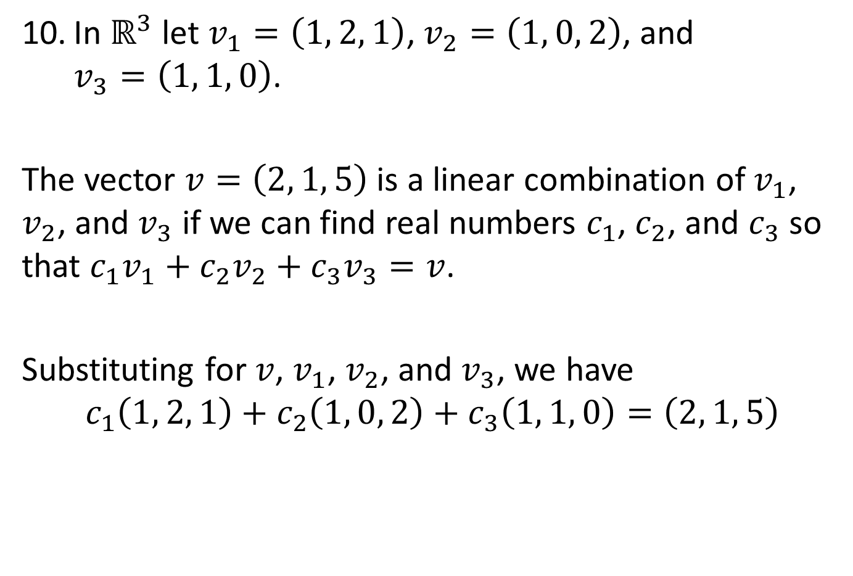
EXAMPLES
In $ℝ^{3}$ let $v_{1}=\left(1, 2, 1\right)$, $v_{2}=\left(1, 0, 2\right)$, and $v_{3}=\left(1, 1, 0\right)$.
The vector $v=\left(2, 1, 5\right)$ is a linear combination of $v_{1}$, $v_{2}$, and $v_{3}$ if we can find real numbers $c_{1}$, $c_{2}$, and $c_{3}$ so that $c_{1}v_{1}+c_{2}v_{2}+c_{3}v_{3}=v$.
Substituting for $v$, $v_{1}$, $v_{2}$, and $v_{3}$, we have
$$c_{1}\left(1, 2, 1\right)+c_{2}\left(1, 0, 2\right)+c_{3}\left(1, 1, 0\right)=\left(2, 1, 5\right)$$

Slide 25
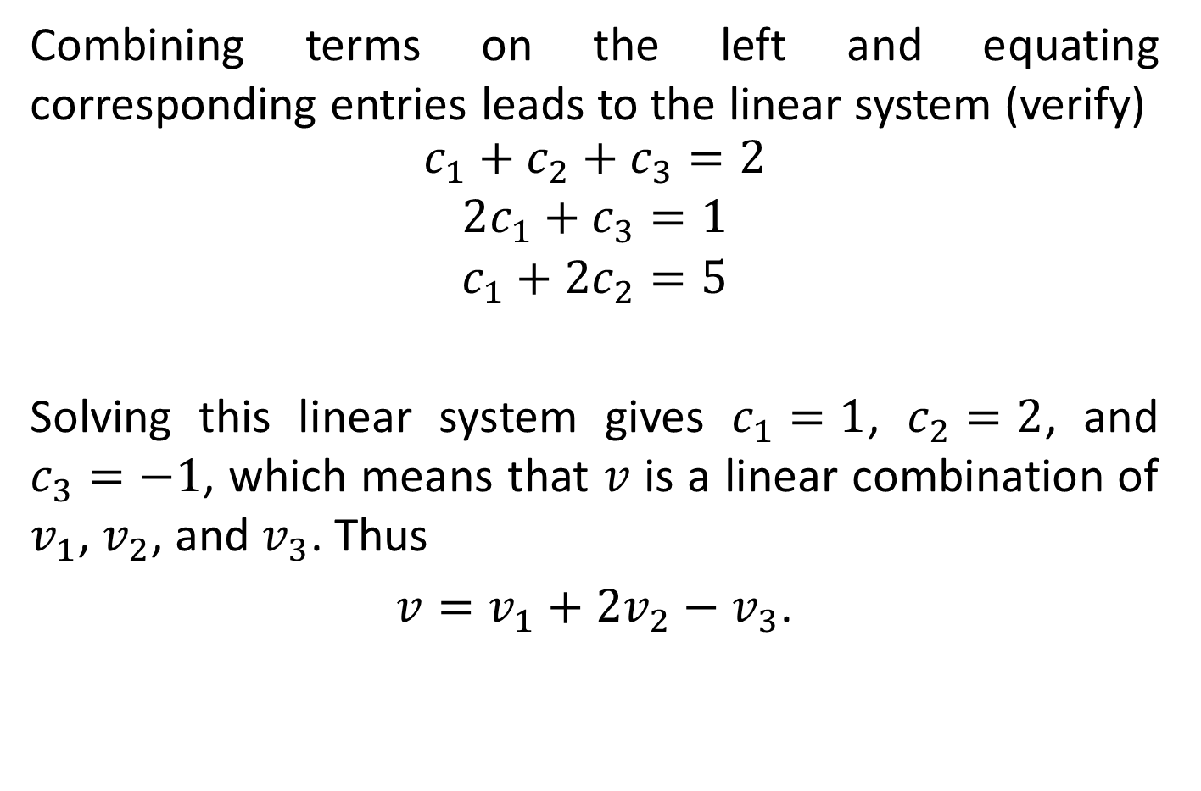
EXAMPLES
Combining terms on the left and equating corresponding entries leads to the linear system (verify)
$$\begin{matrix}c_{1}+c_{2}+c_{3}=2 \\ 2c_{1}+c_{3}=1 \\ c_{1}+2c_{2}=5\end{matrix}$$
Solving this linear system gives $c_{1}=1$, $c_{2}=2$, and $c_{3}=−1$, which means that $v$ is a linear combination of $v_{1}$, $v_{2}$, and $v_{3}$. Thus
$v=v_{1}+2v_{2}−v_{3}$.

Slide 26
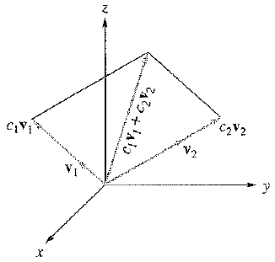
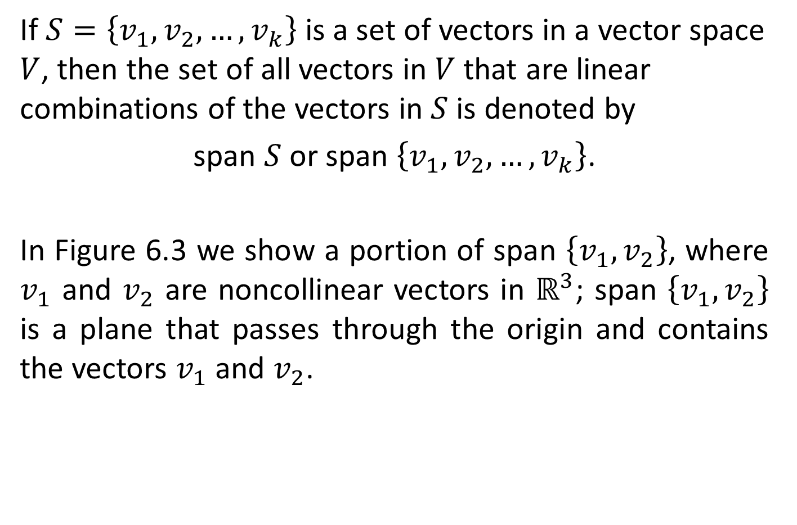
DEFINITION
If $S=\left\{v_{1}, v_{2},…, v_{k}\right\}$ is a set of vectors in a vector space $V$, then the set of all vectors in $V$ that are linear combinations of the vectors in $S$ is denoted by
span $S$ or span $\left\{v_{1}, v_{2}, …, v_{k}\right\}$.
In Figure 6.3 we show a portion of span $\left\{v_{1}, v_{2}\right\}$, where $v_{1}$ and $v_{2}$ are noncollinear vectors in $ℝ^{3}$; span $\left\{v_{1}, v_{2}\right\}$ is a plane that passes through the origin and contains the vectors $v_{1}$ and $v_{2}$.

Slide 27
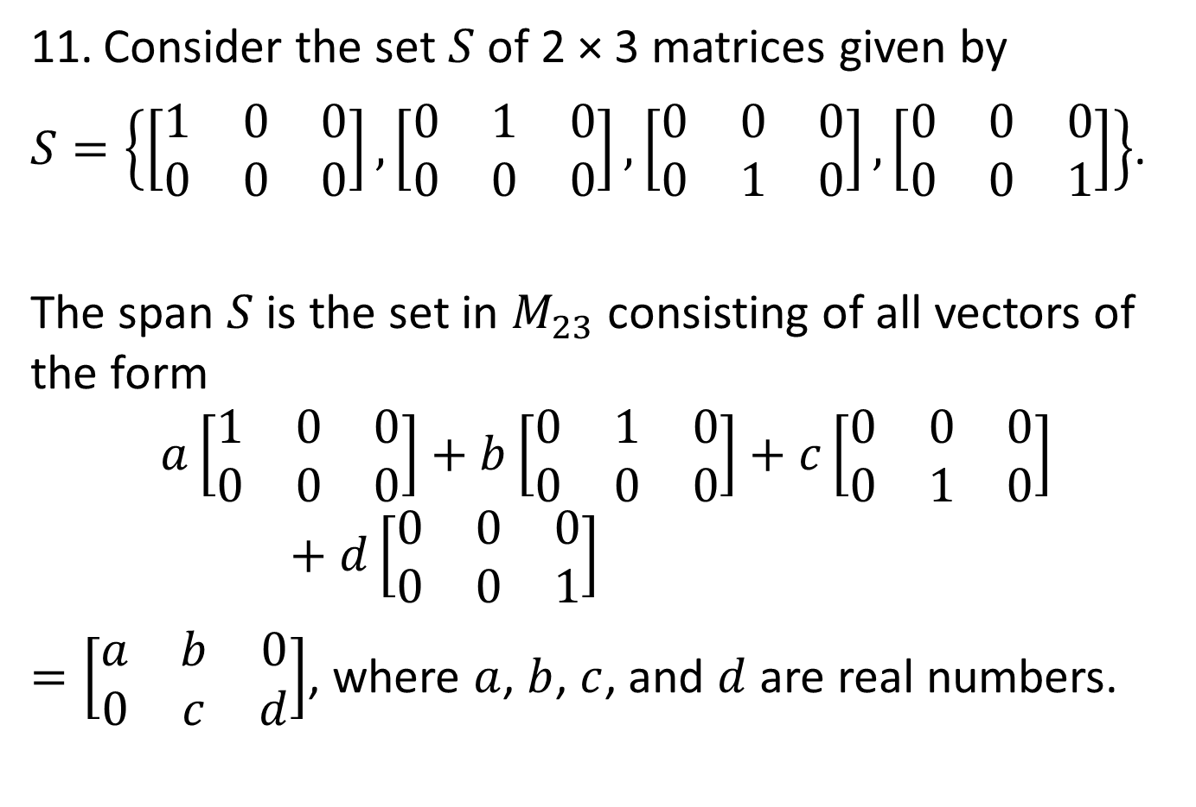
EXAMPLES
Consider the set $S$ of 2 × 3 matrices given by
$S=\left\{\left[\begin{matrix}1 & 0 & 0 \\ 0 & 0 & 0\end{matrix}\right], \left[\begin{matrix}0 & 1 & 0 \\ 0 & 0 & 0\end{matrix}\right], \left[\begin{matrix}0 & 0 & 0 \\ 0 & 1 & 0\end{matrix}\right], \left[\begin{matrix}0 & 0 & 0 \\ 0 & 0 & 1\end{matrix}\right]\right\}$.
The span $S$ is the set in $M_{23}$ consisting of all vectors of the form
$$a\left[\begin{matrix}1 & 0 & 0 \\ 0 & 0 & 0\end{matrix}\right]+b\left[\begin{matrix}0 & 1 & 0 \\ 0 & 0 & 0\end{matrix}\right]+c\left[\begin{matrix}0 & 0 & 0 \\ 0 & 1 & 0\end{matrix}\right]+d\left[\begin{matrix}0 & 0 & 0 \\ 0 & 0 & 1\end{matrix}\right]$$
$=\left[\begin{matrix}a & b & 0 \\ 0 & c & d\end{matrix}\right]$, where $a$, $b$, $c$, and $d$ are real numbers.

Slide 28

EXAMPLES
That is, span $S$ is the subset of $M_{23}$ consisting of all matrices of the form
$\left[\begin{matrix}a & b & 0 \\ 0 & c & d\end{matrix}\right]$,
where $a$, $b$, $c$, and $d$ are real numbers.

Slide 29

THEOREM 6.3
Let $S=\left\{v_{1}, v_{2},…, v_{k}\right\}$ be a set of vectors in a vector space $V$. The span $S$ is a subspace of $V$.

Slide 30

EXAMPLES
In $P_{2}$ let
$$v_{1}=2t^{2}+t+2$$
$$v_{2}=t^{2}−2t$$
$$v_{3}=5t^{2}−5t+2$$
$$v_{4}=−t^{2}−3t−2$$
Determine if the vector $u=t^{2}+t+2$ belongs to the span $\left\{v_{1},v_{2}, v_{3}, v_{4}\right\}$.

Slide 31
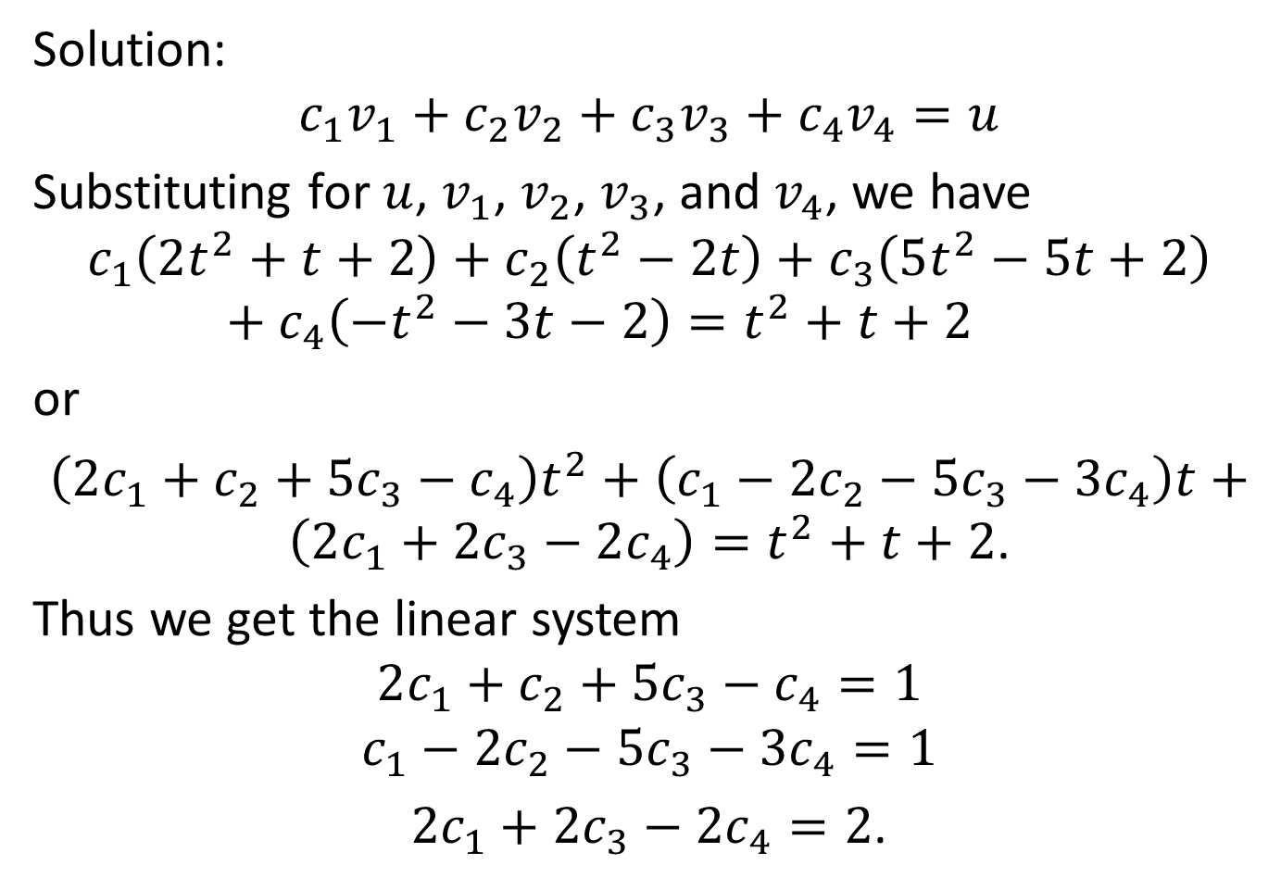
EXAMPLES
Solution:
$$c_{1}v_{1}+c_{2}v_{2}+c_{3}v_{3}+c_{4}v_{4}=u$$
Substituting for $u$, $v_{1}$, $v_{2}$, $v_{3}$, and $v_{4}$, we have
$$c_{1}\left(2t^{2}+t+2\right)+c_{2}\left(t^{2}−2t\right)+c_{3}\left(5t^{2}−5t+2\right)+c_{4}\left(−t^{2}−3t−2\right)=t^{2}+t+2$$
or
$\left(2c_{1}+c_{2}+5c_{3}−c_{4}\right)t^{2}+\left(c_{1}−2c_{2}−5c_{3}−3c_{4}\right)t+\left(2c_{1}+2c_{3}−2c_{4}\right)=t^{2}+t+2$.
Thus we get the linear system
$$2c_{1}+c_{2}+5c_{3}−c_{4}=1$$
$$c_{1}−2c_{2}−5c_{3}−3c_{4}=1$$
$2c_{1}+2c_{3}−2c_{4}=2$.

Slide 32
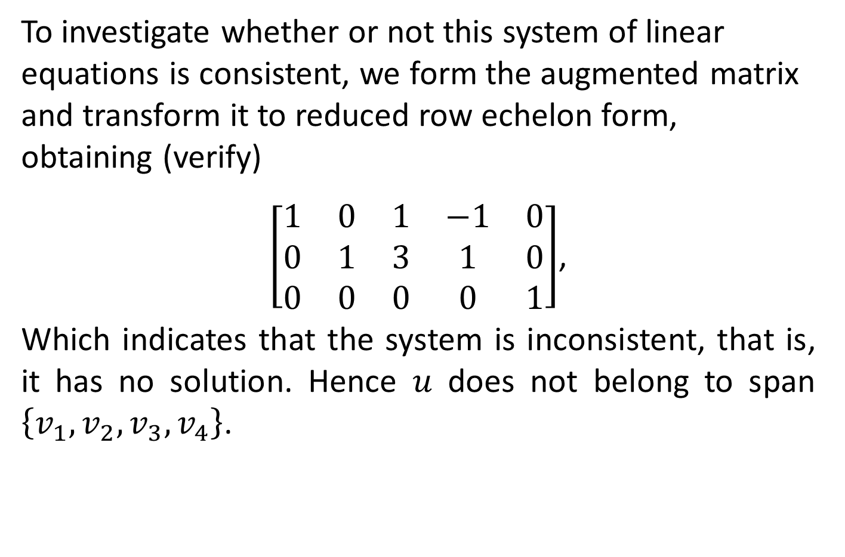
EXAMPLES
To investigate whether or not this system of linear equations is consistent, we form the augmented matrix and transform it to reduced row echelon form, obtaining (verify)
$\left[\begin{matrix}1 & 0 & 1 & −1 & 0 \\ 0 & 1 & 3 & 1 & 0 \\ 0 & 0 & 0 & 0 & 1\end{matrix}\right]$,
Which indicates that the system is inconsistent, that is, it has no solution. Hence $u$ does not belong to span $\left\{v_{1},v_{2},v_{3},v_{4}\right\}$.

